Slide 1


Slide 2

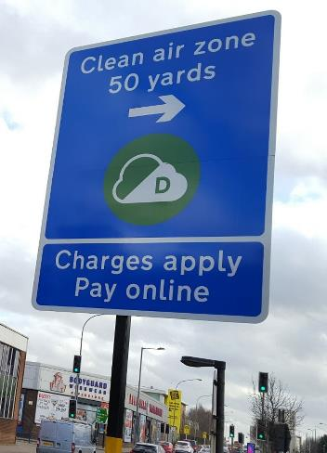
Background
Legal requirement to meet nitrogen dioxide limits as soon as possible
Public health measure
71% of vehicles already clean enough
Rising to over 80% before introduction

Slide 3
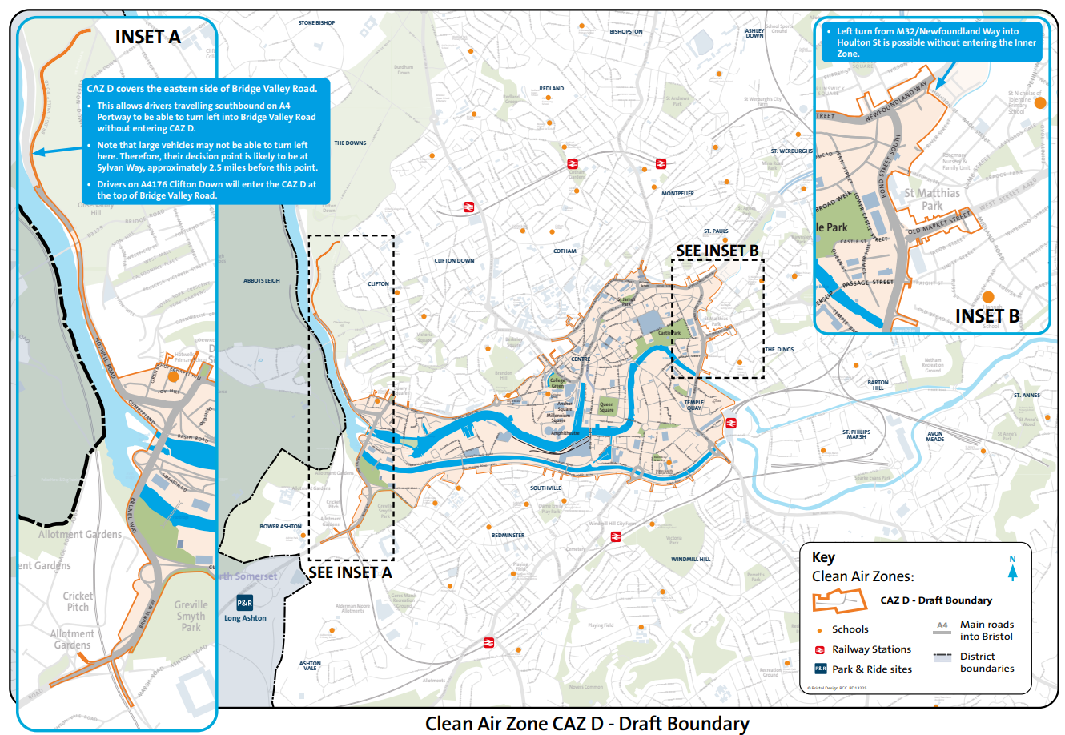

Slide 4
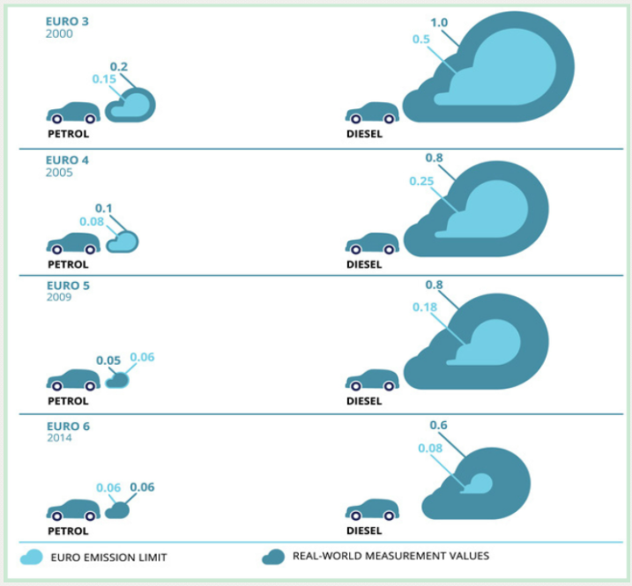

Slide 5
Timescales
November 2021 onwards
Register interest for finance support
January 2021
Begin issuing finance support and travel vouchers
Summer 2022
Zone starts operating

Slide 6
Support
Bid for support increased by £10m to £46m
£1.8m for low-income earners, residents and workers in zone
Low-income threshold increased to £26,000 and rising to £27,000
£32m to help businesses upgrade to cleaner vehicles
£2.1m for bus and coach companies
£2m for Freight Consolidation
Extensive support to help people switch to cleaner ways of travelling

Slide 7
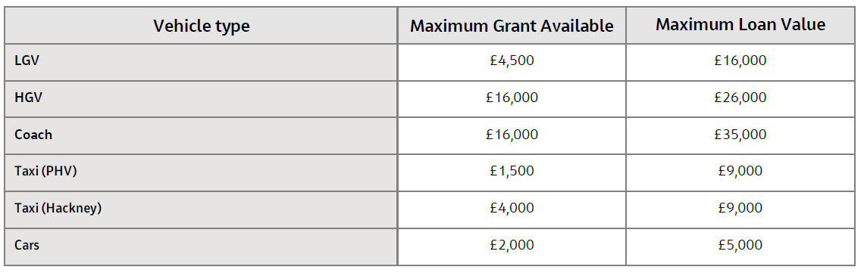
Support – per vehicle
Priority groups Low income residents and workers within the zone, SMEs, charities operating within the zone
£4,000

Slide 8
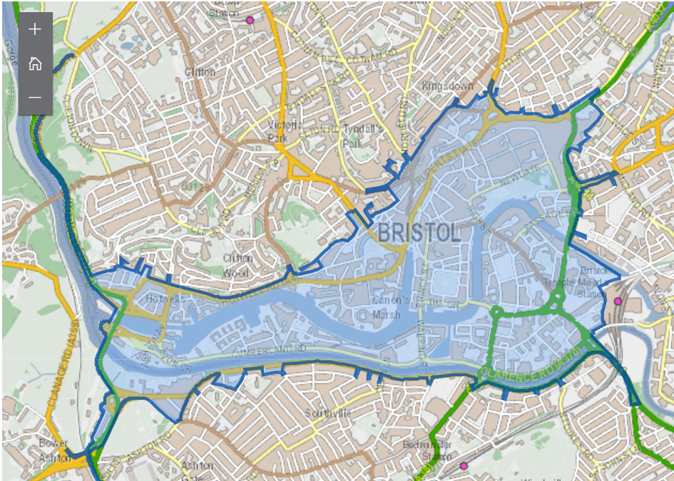
Exemptions
Give people time to upgrade vehicles, access support and switch to cleaner ways of travelling.
Residents and businesses in zone or working in zone
Low-income earners
Patients and long-term visitors to BRI hospitals
Specialist vehicles
Community transport vehicles
Blue badge holders
Disabled tax class vehicles

Slide 9
Communication and engagement
City-wide and regional campaign/promotions
Dedicated call centre and travel advisors
Business and community toolkits
Engagement support tailored to your needs

Slide 10
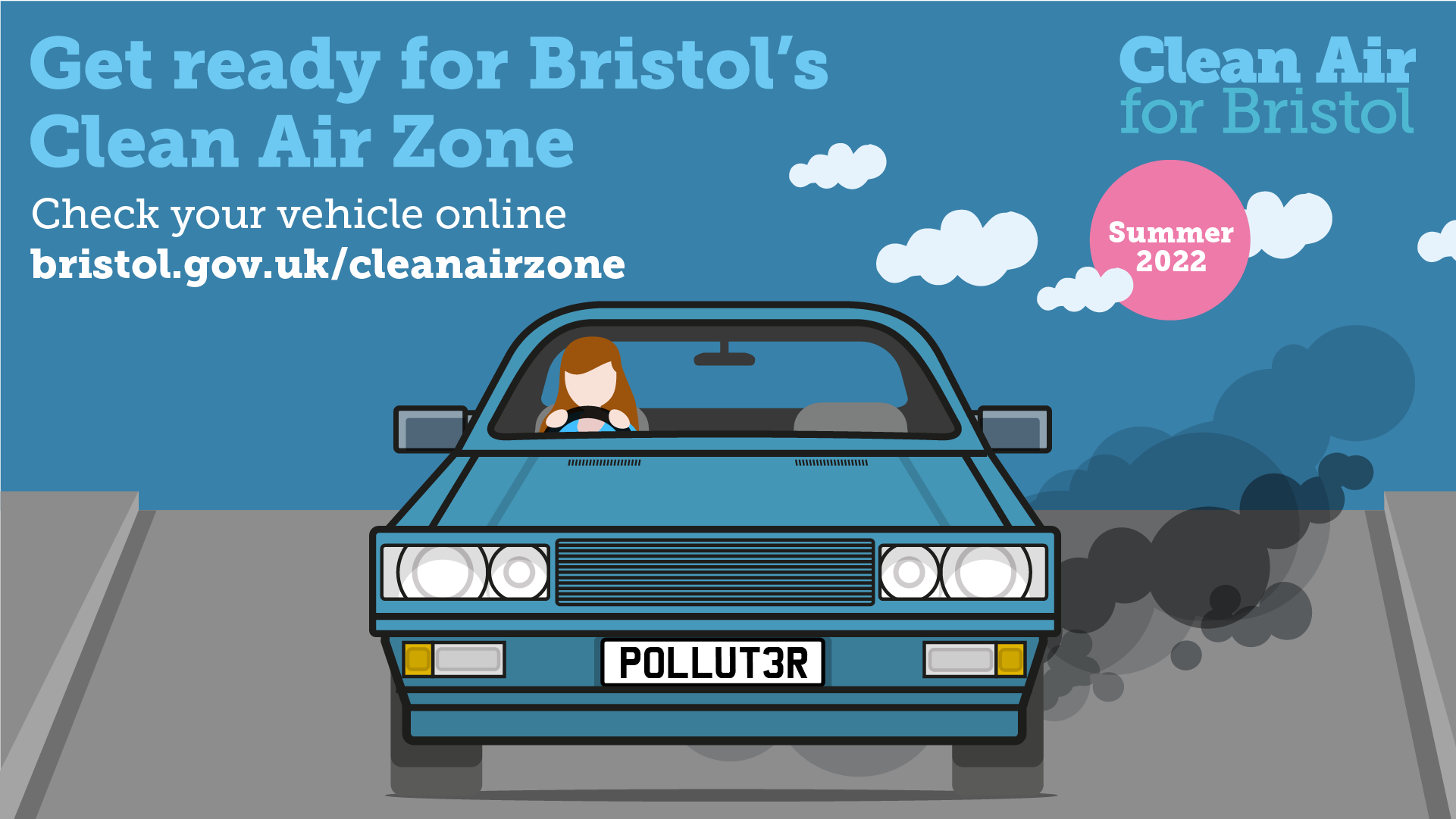
Raising awareness

Slide 11
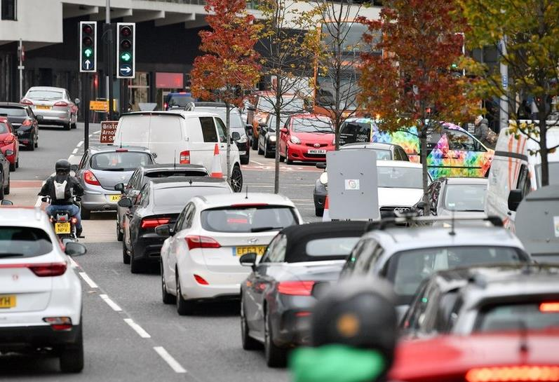
Engagement
Autumn/winter: Raising awareness
what, where, why, how
Zone
launch
Winter/spring: Get ready
check, financial support, apply for exemptions and support
Spring/summer: Behaviour change
travel planning, travel vouchers

Slide 12
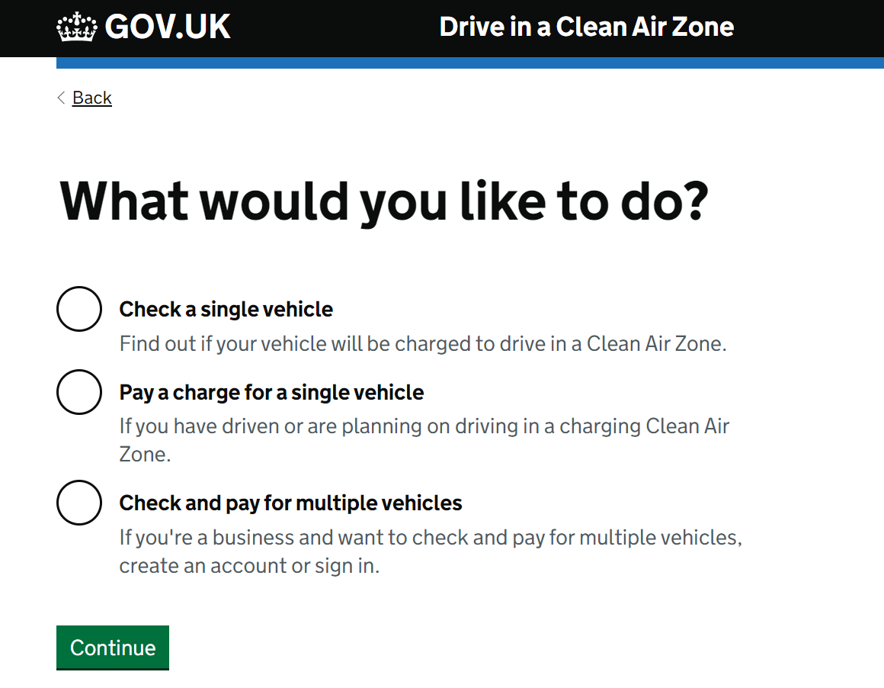
Your next steps
Government Vehicle Compliance Checker
Check your fleet
Encourage staff to check their vehicles

Slide 13
Your next steps
Register your interest for financial support
Use the form at bristol.gov.uk/caz
Input your fleet vehicles
Share with staff and suppliers

Slide 14
Your next steps
What can you do now?
Introduce salary sacrifice car and cycle schemes
Micro-consolidation for deliveries
Review internal travel policies
Use the existing TravelWest support offers

